Slide 1
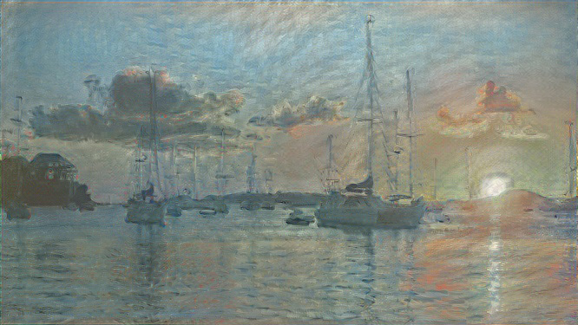
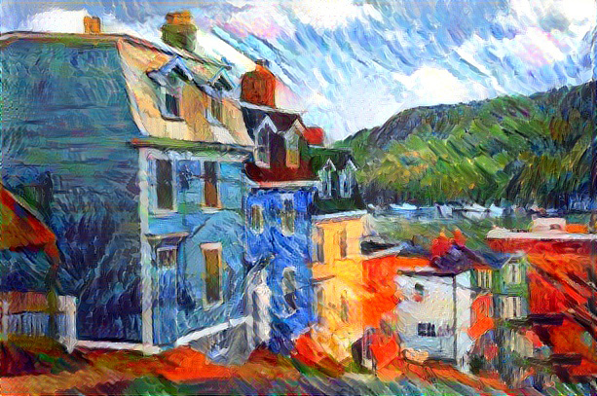
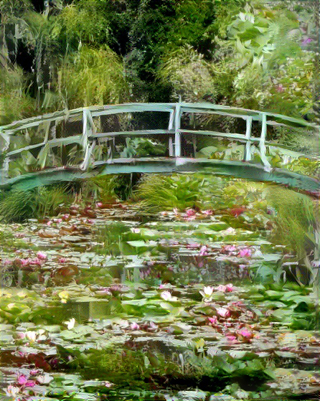
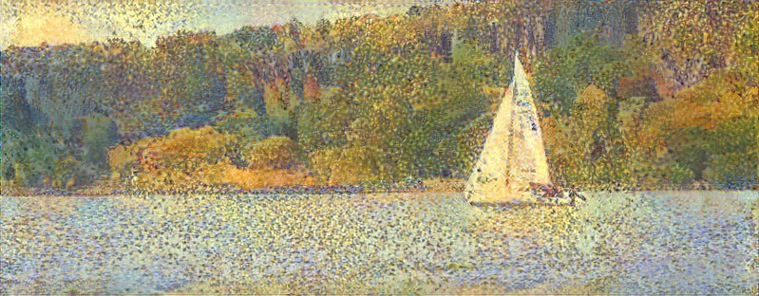
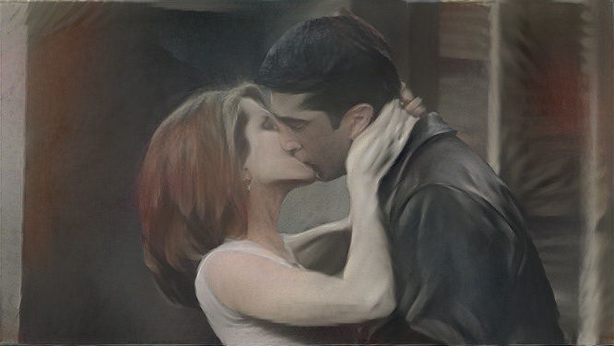
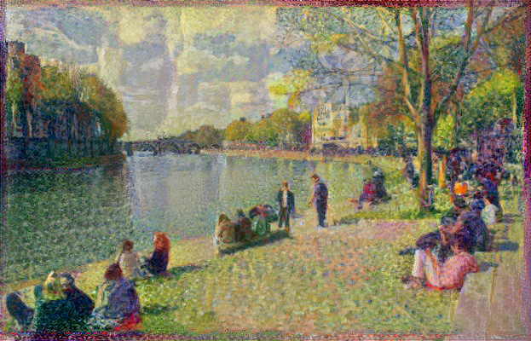
Artistic Style Transfer:
How Convolutional Breaks from Convention
Miles Shebar
IPHS 391 – AI for the Humanities
INTRODUCTION
RESULTS
CONCLUSION
I set out to explore Neural Network generated artwork, specifically in regards to how Artificial Intelligence reinterprets techniques via artistic style transfer. I focused my research on where AI breaks from artistic convention, even in scenarios where the photo the network is trained on is very similar to the scene the painting depicts.
While the neural net was by and large very effective at painterly mimicry (especially in color palette), there were also many noticeable ways in which it deviated from each painter’s techniques.
In the case of Impression: Sunrise, I was largely impressed with the CNN’s use of desaturated orange and blue tones and its abstraction of the mastheads in the harbor. But the biggest variance in style for me appears in the CNN’s more photoreal rendering of the sun, which appears a pure white, as opposed to the deep orange Monet used. This style is far more faithful to how a setting sun would look to an overexposed camera than it would to the human eye.
In Uferlandschaft, the CNN represents Cezanne’s color palette faithfully, but fails to eliminate or otherwise obscure the more minute details that he does, especially with the houses. It also doesn’t add a black border to a lot of its points of contrast, like where the mountains and houses meet the sky.
The neural net had the most difficult time with Magritte’s works, I think largely because his paintings are often very close to photoreal, despite some surreal element(s). In the rendered version, the female subject’s hand takes on the ghostly, shadowy appearance of the cloth that covers the heads of the lovers in the original. While I think this was one of the least accurate style transfers the CNN performed, it was still interesting to see how it noted a visual similarity between the veins, wrinkles, and folds in her hand and the cloth.
In Seine à la Grande Jatte, the color scheme is also faithfully preserved, even in the sail color and the color of the water. This was one of the most accurate style transfers I saw from the CNN, but it would be interesting to see it try to depict another human figure like the kayaker in the original painting.
Monet’s Water Lilies and Japanese Bridge presented the most interesting deviation from the artist’s established color palette, as the CNN colored the image very much like the original photograph – far more saturated and contrasty than Monet’s original work. As we saw with Impression: Sunrise, pixel values at the extreme ends of the color spectrum (pure white and pure black) present some of the most interesting challenges to accurate representation. In Monet’s work, the flora and fauna behind the bridge form a flat, non contrasty wall, but in the photograph, this flat background is broken up by underexposed dark pockets, small clearings in the trees. The CNN does not recolor or modify many of these dark spots, choosing instead to leave them as they are.
While many of these stylistic changes could easily be remedied or at least mitigated with a better algorithm, higher-resolution photos, or an army of TPUs spinning away in the cloud, it was still interesting to see how the computer works differently from humans in the stylistic choices it makes. Even when it’s doing its utmost to replicate one.
METHODOLOGY
I selected a few famous works from the painters Magritte, Seurat, Monet, and Cezanne. I then found a corresponding image for each work that I deemed to be similar in composition. Then, I ran those images through a convolutional neural net (CNN) that was trained on their corresponding painting. Below is a selection of some of the paintings (left) and their visually similar images (right).
Monet’s Impression: Sunrise
Cezanne’s Uferlandschaft
Magritte’s The Lovers
ACKNOWLEDGEMENTS
Seurat’s La Seine à la Grande Jatte
This project would not have been possible without Logan Engstrom’s fast-style-transfer project.
Monet’s Water Lilies and Japanese Bridge

